Slide 1
Introduction to Reinforcement Learning
A mini course @ HCMUS, Vietnam
Lectures 7-9
Long Tran-Thanh
long.tran-thanh@warwick.ac.uk
University of Warwick, UK

Slide 2
RLHF + LLM Agents

Slide 3
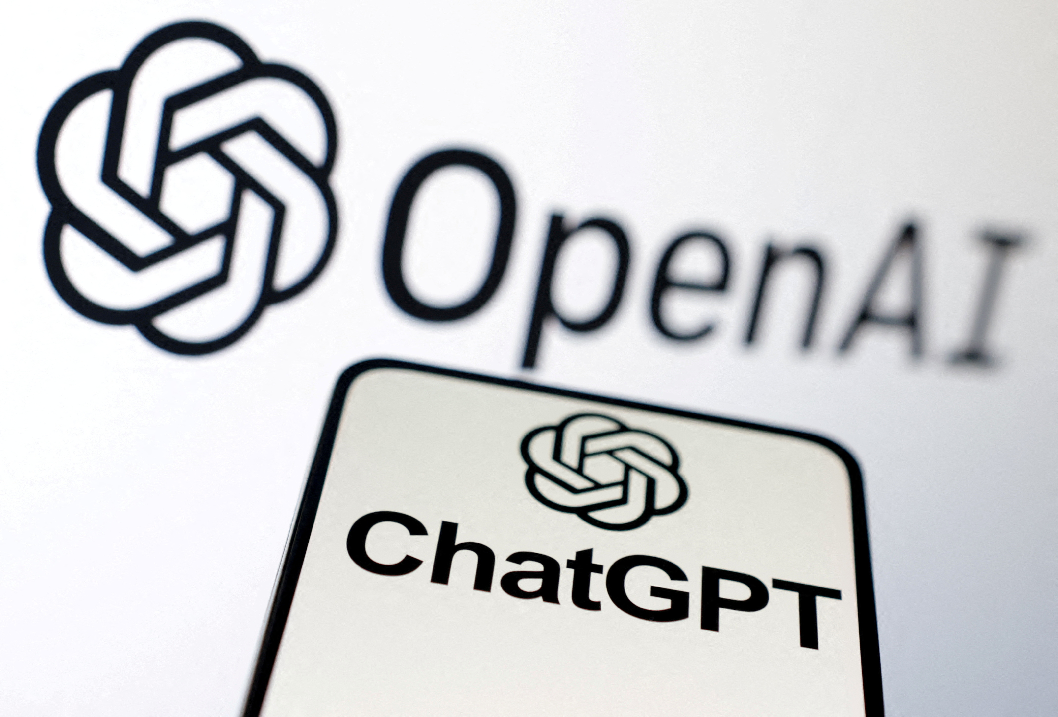

A Brave New World (of AI)
100 million users after 2 months after launch - fastest-growing consumer application in history
Disruptive in many areas of our lives:
First book completely written by ChatGPT
Solving maths problems
Summarising large volume of text
Translator
Newer heroes: Mistral, DeepSeek, Manus,…
REUTERS/Dado Ruvic/Illustration//File Photo
https://medium.com/enrique-dans/google-launches-gemini-but-again-fails-to-impress-anyone-a5a9bf7dd73d

Slide 4
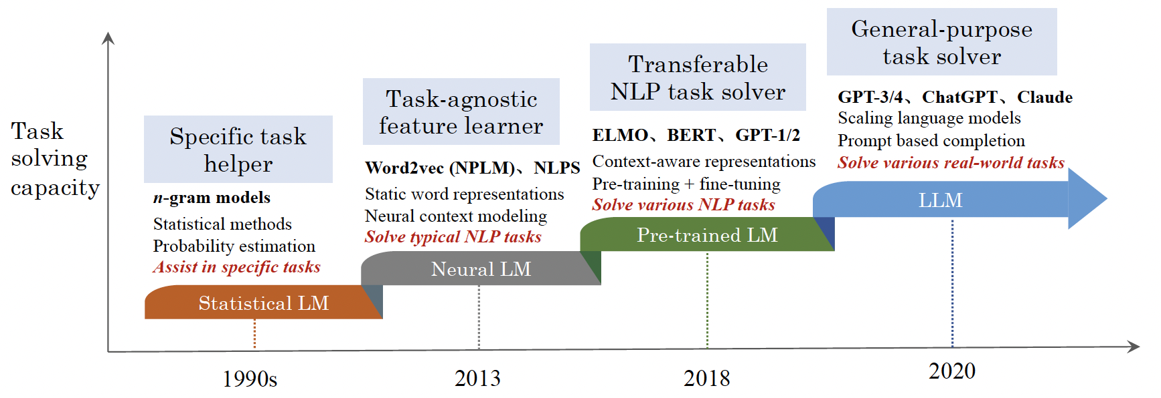
The Evolution of LLMs
Large Language Model (LLM): large deep neural network (e.g., GPT-4 has 1.7 trillion parameters), pre-trained on very large data
Zhao et al. (2023): https://arxiv.org/pdf/2303.18223.pdf

Slide 5

Application 1: LLMs in Education
Can pass many university exams with > 90% success rate
Can write many Python/Matlab codes
Can produce circuits diagrams
Write philosophical essays
Image source: ChatGPT in education | Turing College

Slide 6
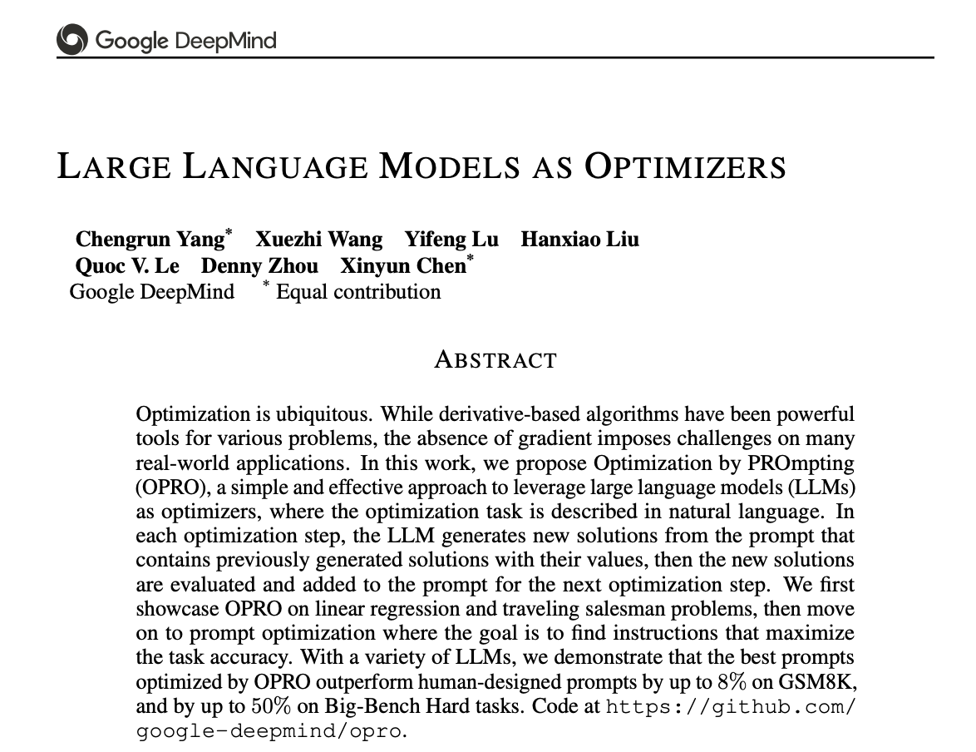
Application 2: LLMs as Optimiser
Prompt based search mechanism
Optimisation step:
LLM generates new solutions from the prompt that contains previously generated solutions with their values
new solutions are evaluated and added to the prompt for the next optimization step.

Slide 7

Application 3: LLMs as Virtual Assistant
High level personalisation via prompt queries:
Personal health assistant
Customer support chatbot
HR assistant
https://www.searchunify.com/blog/introducing-searchunify-virtual-assistant-suva-an-llm-powered-chatbot-for-proactive-support/

Slide 8

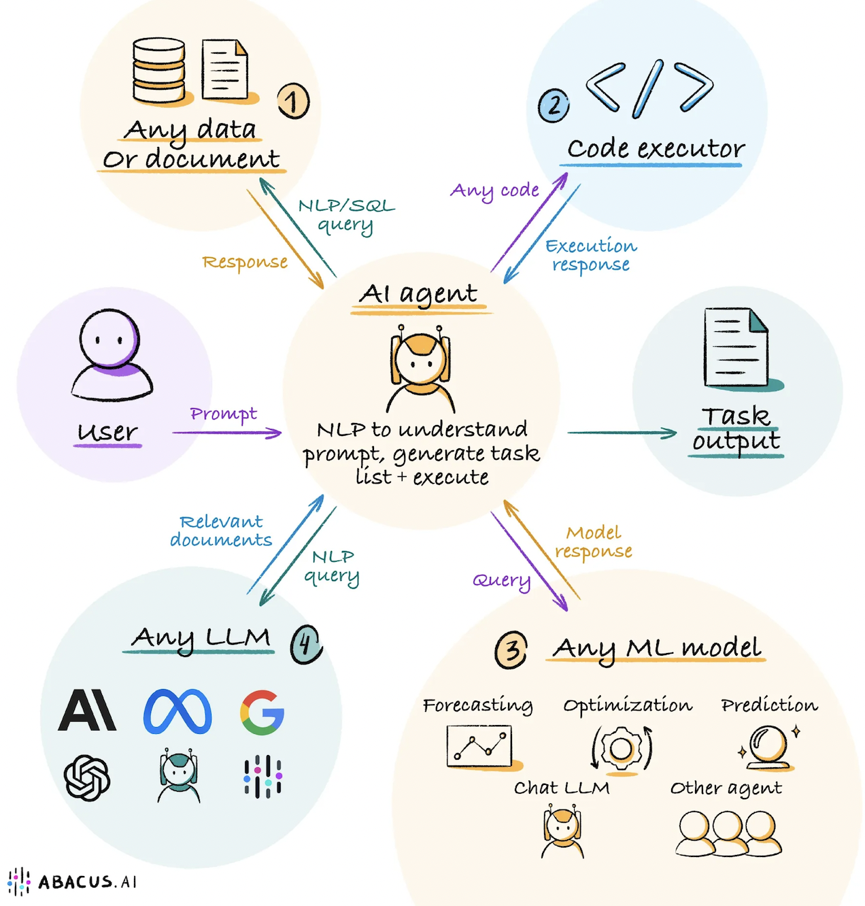

LLMs as Agents
From prompt engineering…. to autonomous LLM agents
metamorworks/Getty Images

Slide 9


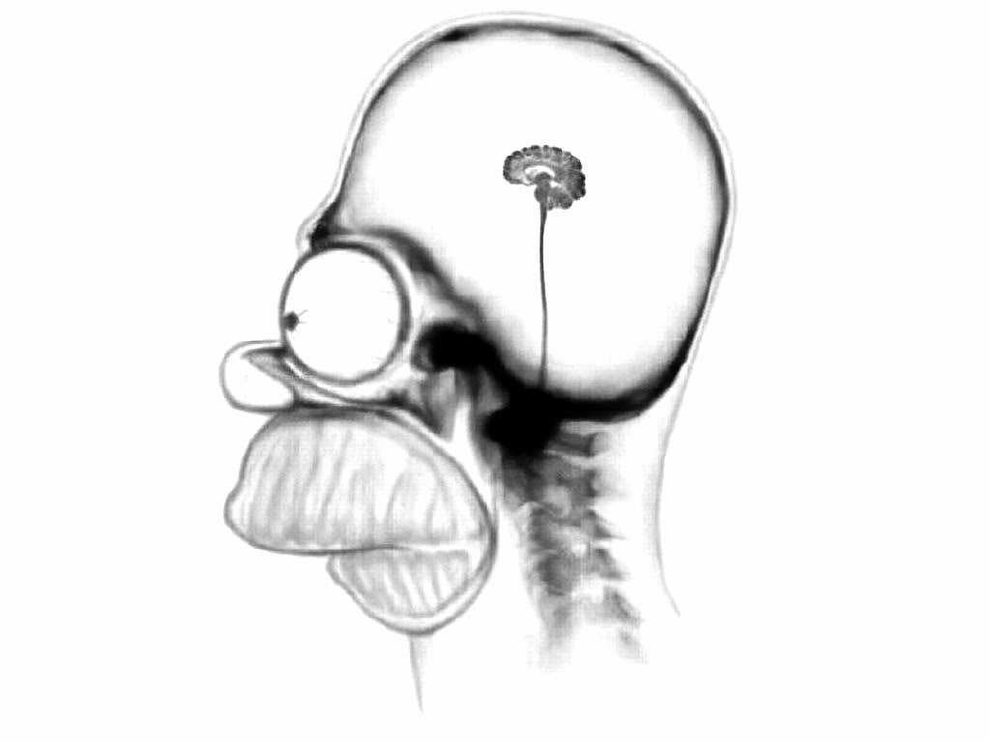
Agent Model
Perception
Environment
Action
LLM
Perception
information processing
Update decision making policy
Update belief model
Action selection
Action

Slide 10
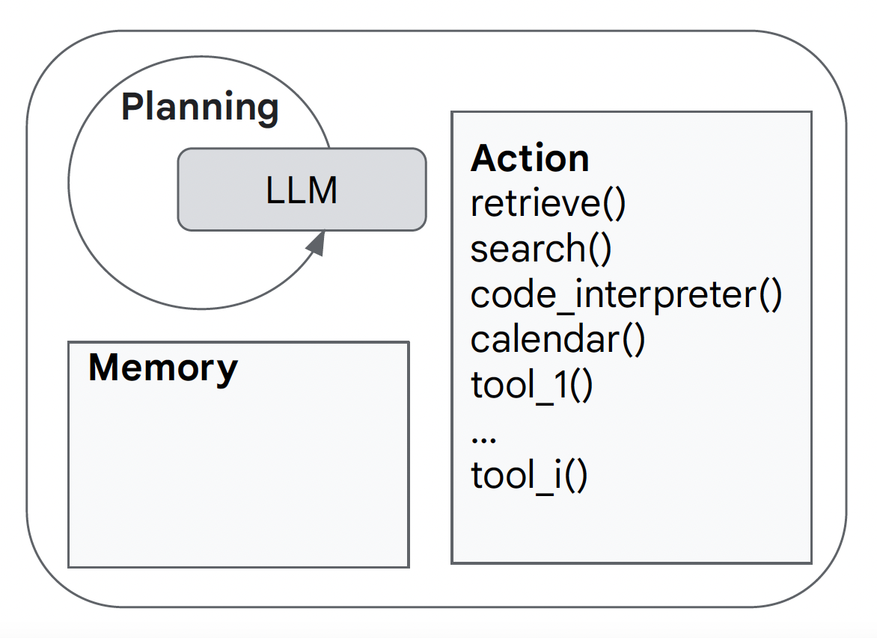
LLM Agent Model
Perception
Environment
Action
RAG = retrieval augmented generation
(Courtesy of Nora Kassner)

Slide 11
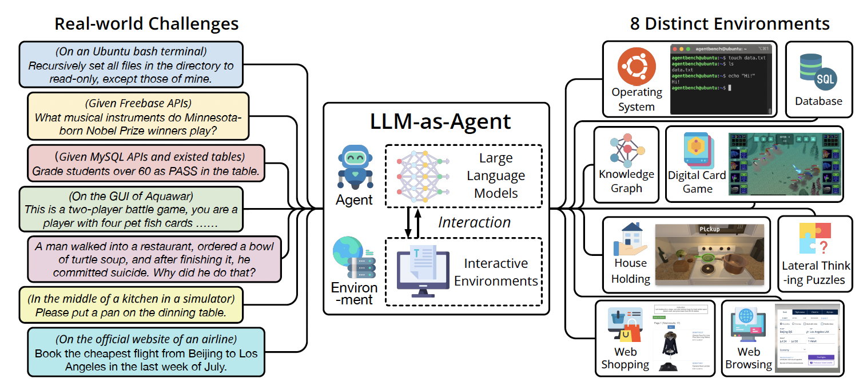
LLM Agent Benchmark Frameworks
AgentBench: Liu et al. (2023)

Slide 12
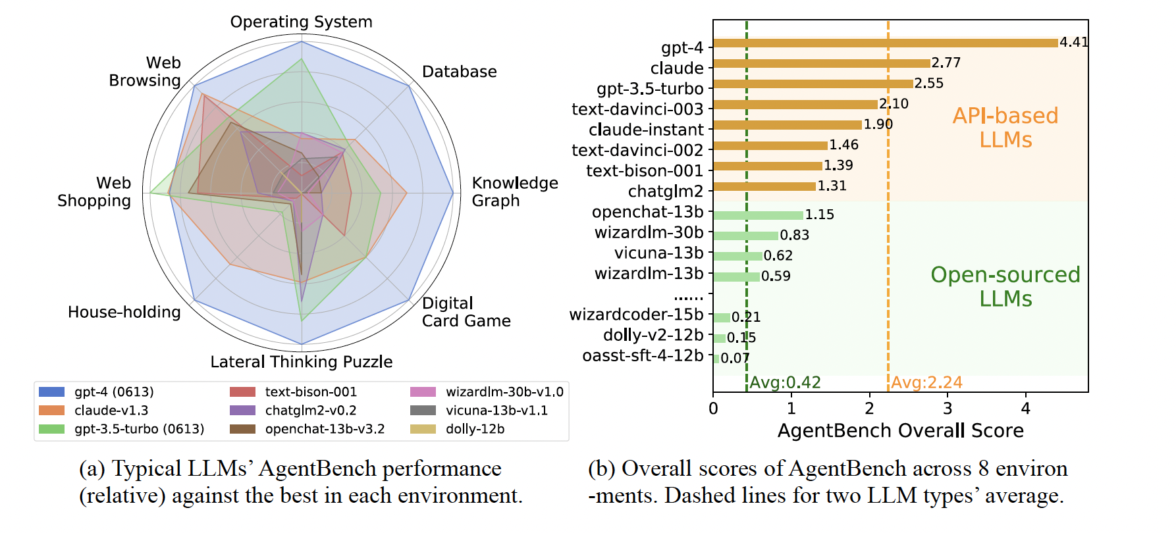
LLM Agent Benchmark Frameworks (cont’d)
AgentBench: Liu et al. (2023)

Slide 13
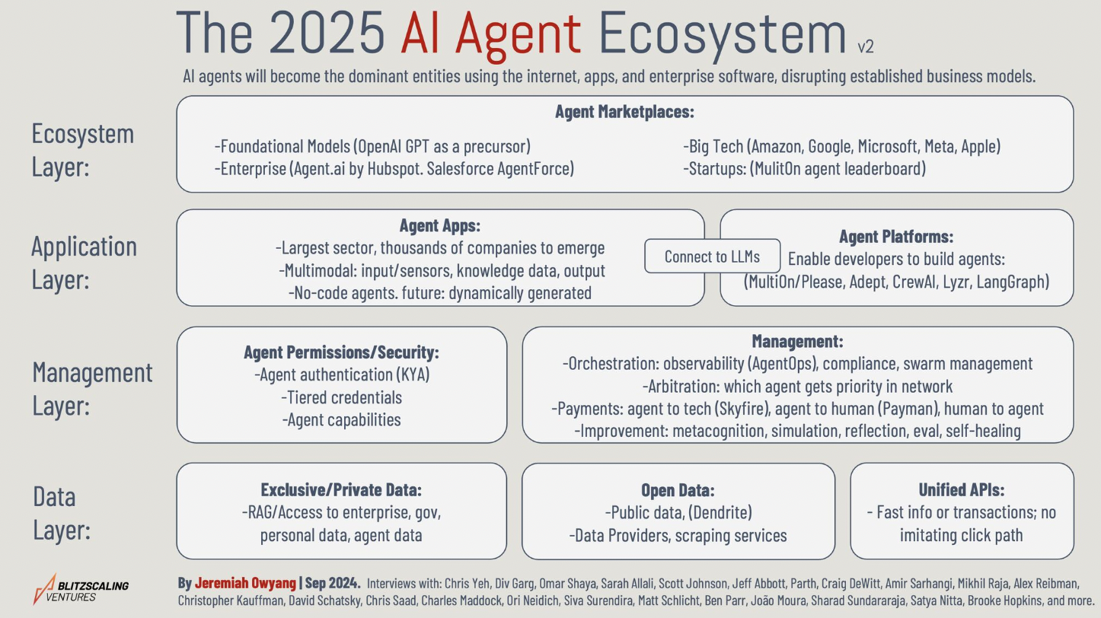

Slide 14

LLM Agents in the Wild 1
Exploit each other:
Deceive their human users/fellow agents (e.g., to steal their money) (Scheurer et al., ICLR workshop’24)
Without being caught
(Wang et al., ICML workshop’24)

Slide 15

LLM Agents in the Wild 2
Selfish behaviour causes system collapse:
Piatti et al., Arxiv’24 (e.g., financial system’s collapse)

Slide 16

Need for Aligning AI Agent Behaviour to Human Values

Slide 17
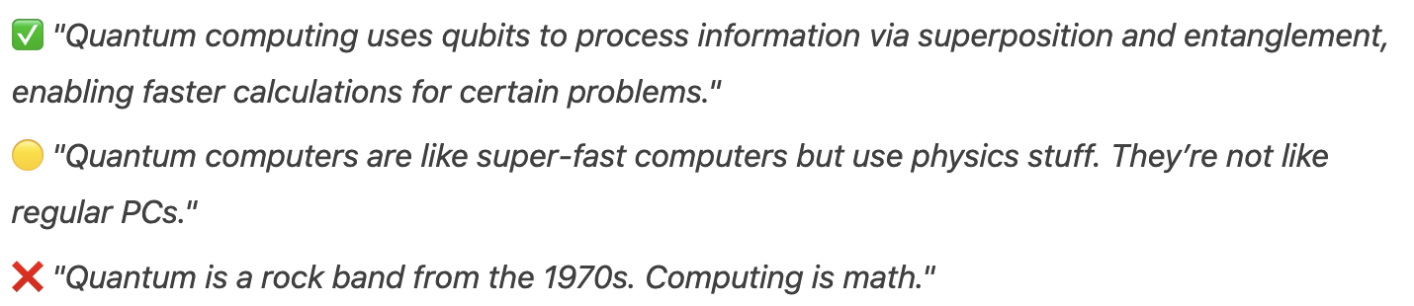
The Alignment Problem
Target: chose the most human-like/ethical/fair/etc answer

Slide 18
Enter the RLHF
RLHF – Reinforcement Learning with Human Feedback
High level idea:
Dialog with LLM = RL
(prompt, answer) = (state, action) // Why?
Policy = LLM
Alignment with human behaviour = train on data of human feedback
Learning optimal policy = training LLM with alignment

Slide 19
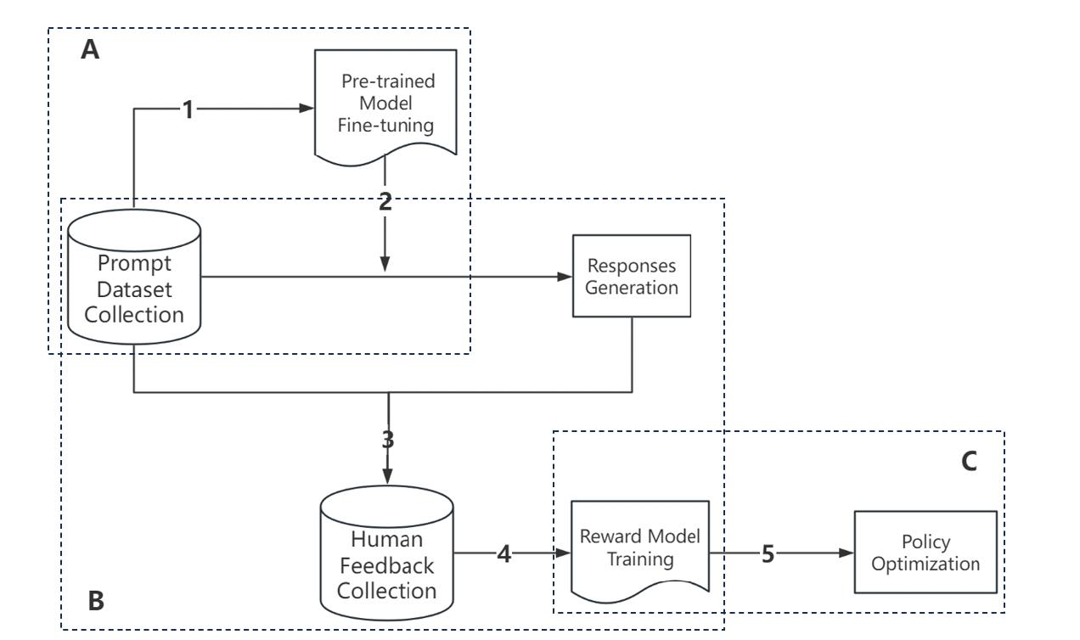
Enter the RLHF
Key components:
A: Supervised fine-tuning
B: reward model training
C: RL policy optimization

Slide 20
Steps in RLHF
A: Supervised fine-tuning
Get a (pre-trained) LLM model (e.g., GPT, Llama, etc)
Fine-tune on a domain specific dataset
B: Learning the reward model
Idea: to learn the human users’ preferences when choosing the most appropriate answers

Slide 21
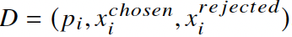
Reward Model (the Human Feedback part)
B: Learning the reward model
High level mathematical model: for each prompt p, assume there’s an underlying function r (reward function) such that for 2 answers :
How to learn this r function?
Step 1: get data samples via human feedback:
Step 2: train on this dataset. Typical training methos:
Smaller Pre-trained LLMs (usually 10x smaller ones, e.g., OpenAI uses GPT-3)
Contrastive learning (Claude from Anthropic)

Slide 22
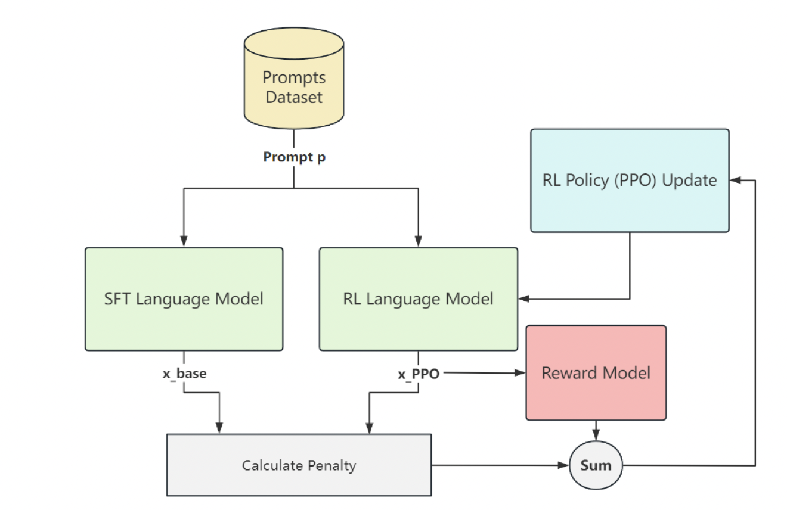
Fine-tuning the LLM with RL
C: RL policy optimization
Recall policy = LLM
Use PPO (or GRPO) to optimise
Compare with base LLM to anchor the optimisation process (so the optimised one will not deviate too much)
This is done by incorporating a penalty component into the final reward value

